Slide 1
Lecture 22

Slide 2
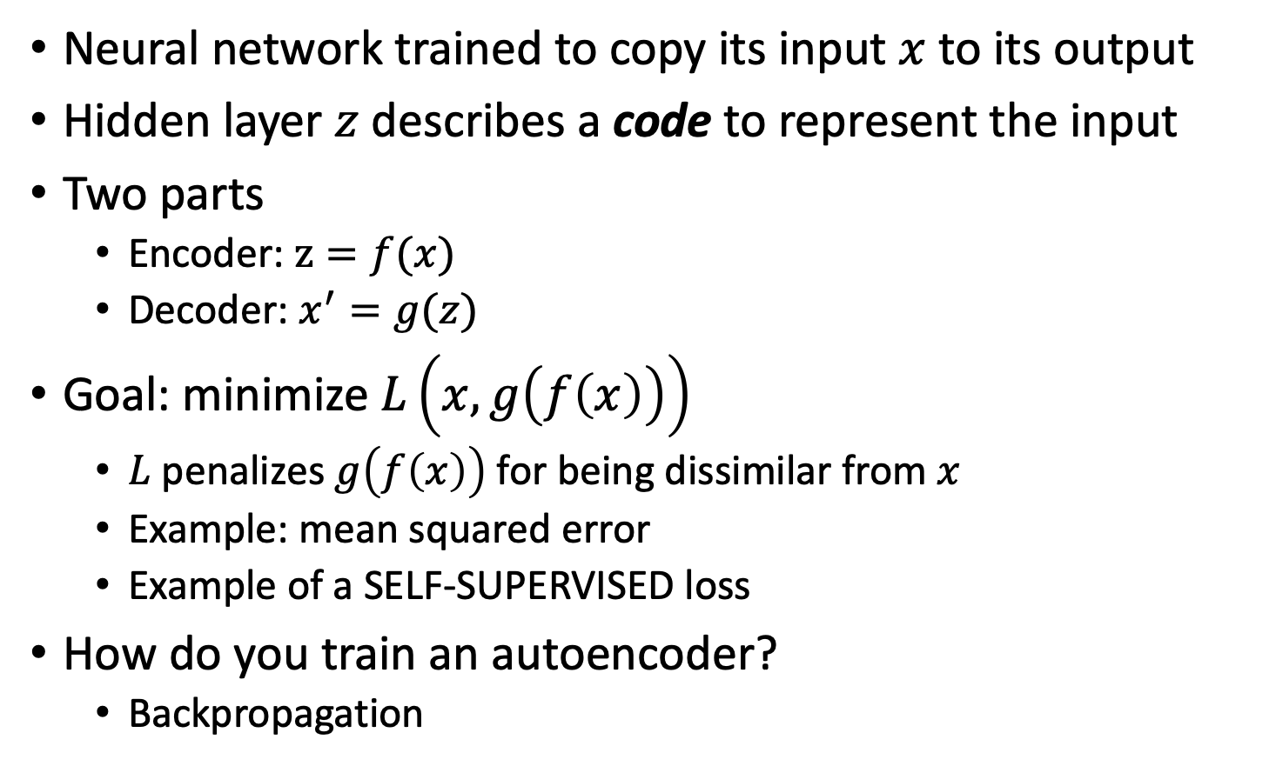
Autoencoder (AE)
Neural network trained to copy its input $x$ to its output
Hidden layer $z$ describes a code to represent the input
Two parts
Encoder: $z=f(x)$
Decoder: $x^{′}=g(z)$
Goal: minimize $L\left(x,g\left(f\left(x\right)\right)\right)$
$L$ penalizes $g\left(f\left(x\right)\right)$ for being dissimilar from $x$
Example: mean squared error
Example of a SELF-SUPERVISED loss
How do you train an autoencoder?
Backpropagation
Notes:
Autoencoders are special types of neural networks that have been used to do unsupervised and semi-supervised settings
Recirculation compares activations of the network on the original input to the activations on the reconstructed input (considered more biologically plausible)

Slide 3

Autoencoder
previous approach: pretrain NN as autoencoder, take of decoder to use for NN
Trained on reconstruction error ||X-X’||²
Informational Bottleneck
Reconstruction Error
[Hinton, Salakhutdinov, Science 2006]
Notes:
Here is an example of an autoencoder. The autoencoder tries to reconstruct its input, after passing it through the layers of the network.
Notice that there is an informational bottleneck here that we’ll talk about in a second.

Slide 4
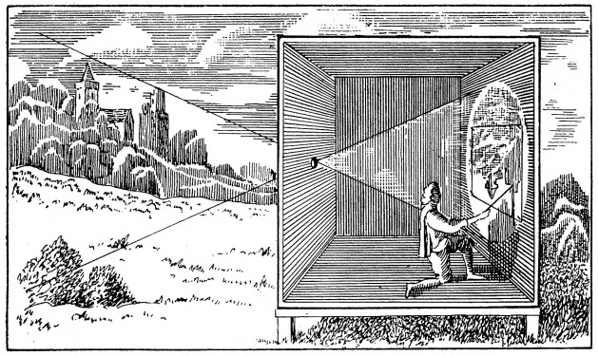
Camera Obscura
Input
Encoder
Hidden Representation
Decoder
Camera Obscura, the renaissance autoencoder
Notes:
We can use the Camera Obscura as an analogy for the autoencoder. The scenery is in the input data. The pinhole is the encoder that creates a representation of the data by projecting it. The painter is the decoder that tries to recreate the image from the encoded representation as best as possible.
The encoder and decoder are a set of layers that act as an informational bottleneck, which is achieved by various types of regularizations or the architecture of the AE.

Slide 5
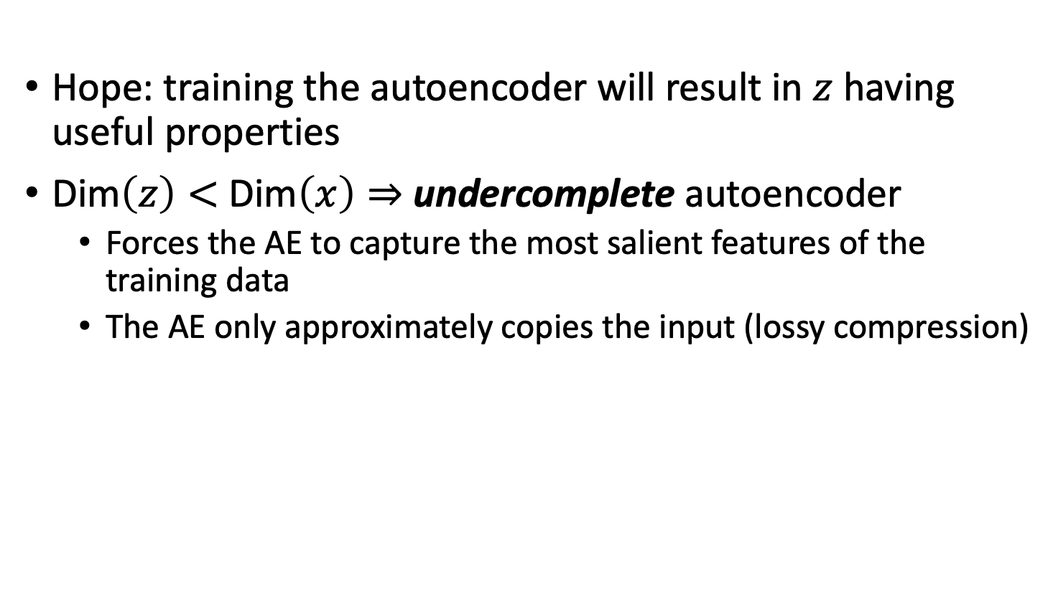
Undercomplete Autoencoders
Hope: training the autoencoder will result in $z$ having useful properties
Dim$\left(z\right)<$ Dim$\left(x\right)⇒$ undercomplete autoencoder
Forces the AE to capture the most salient features of the training data
The AE only approximately copies the input (lossy compression)

Slide 6
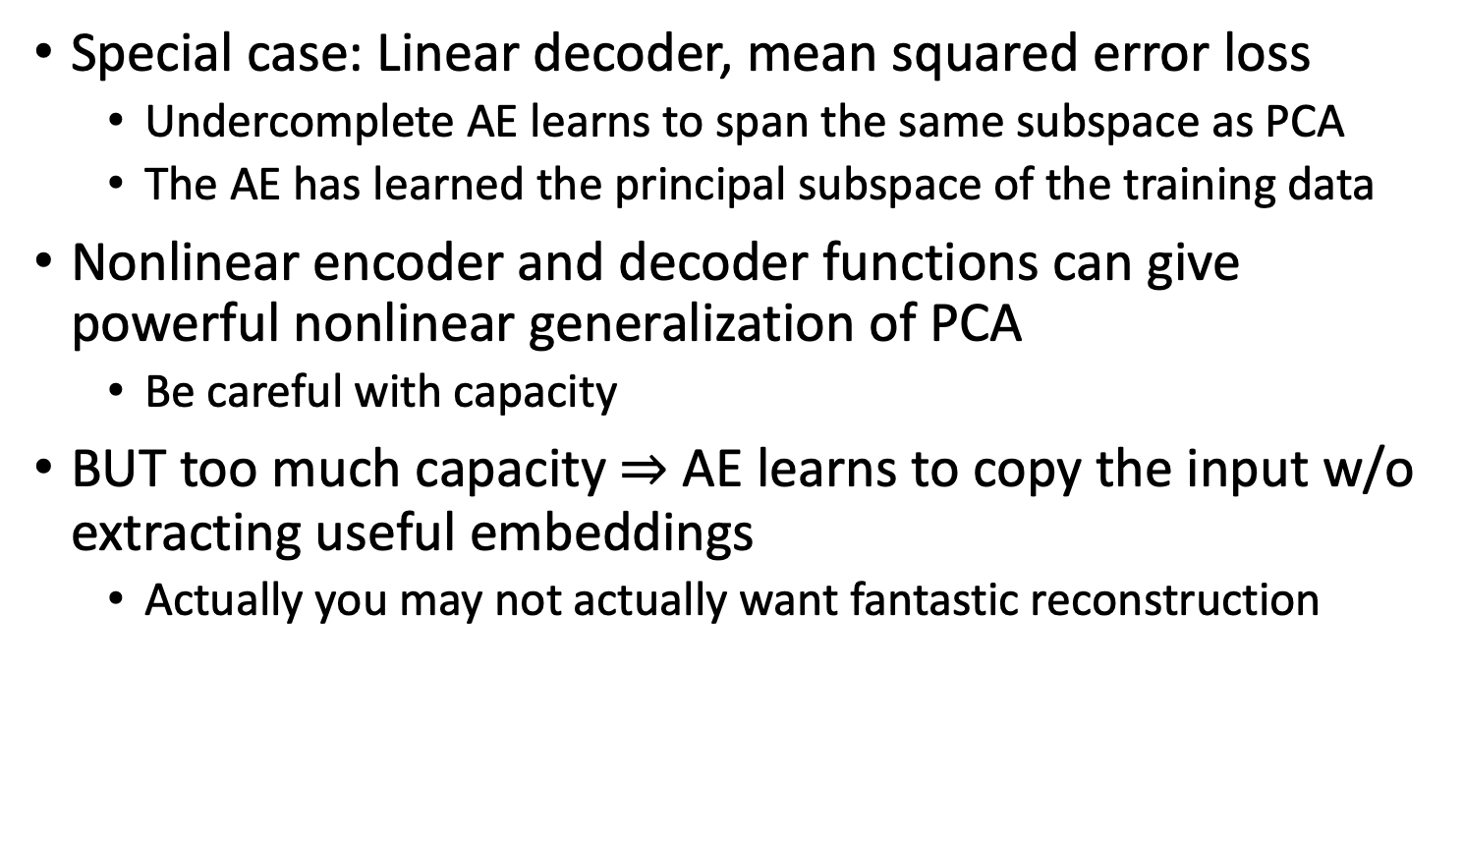
Undercomplete Autoencoders
Special case: Linear decoder, mean squared error loss
Undercomplete AE learns to span the same subspace as PCA
The AE has learned the principal subspace of the training data
Nonlinear encoder and decoder functions can give powerful nonlinear generalization of PCA
Be careful with capacity
BUT too much capacity $⇒$ AE learns to copy the input w/o extracting useful embeddings
Actually you may not actually want fantastic reconstruction

Slide 7
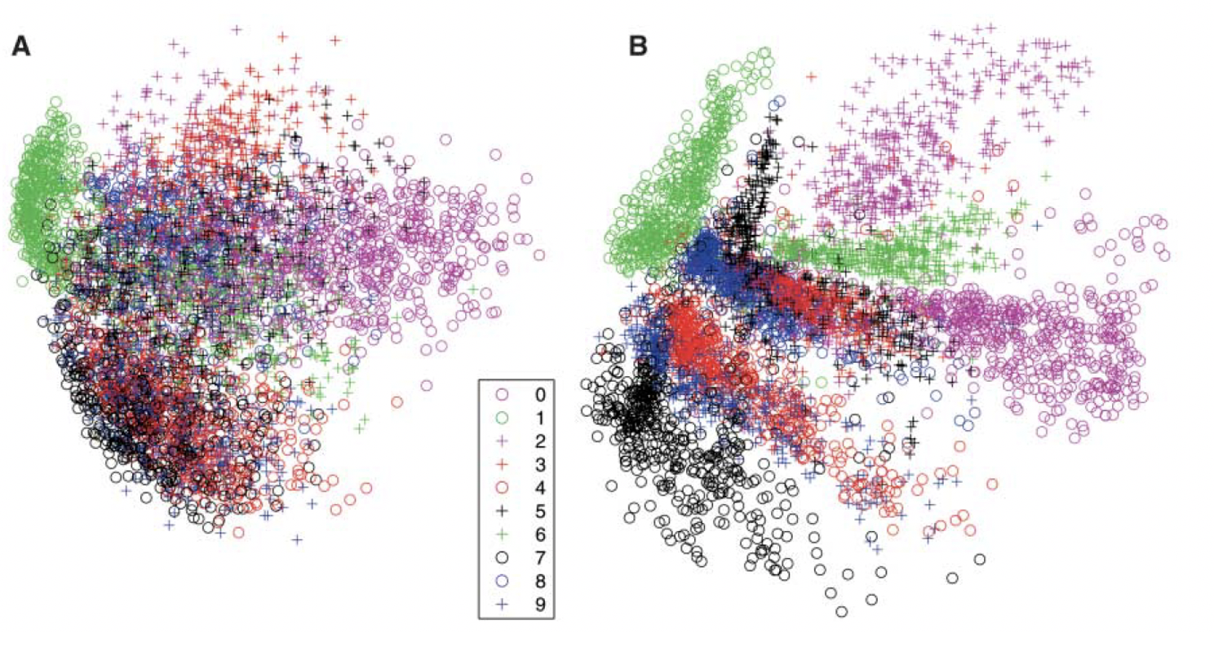
AE MNIST
PCA
Autoencoder
behaviors are like PHATE, UMAP, t-SNE

Slide 8
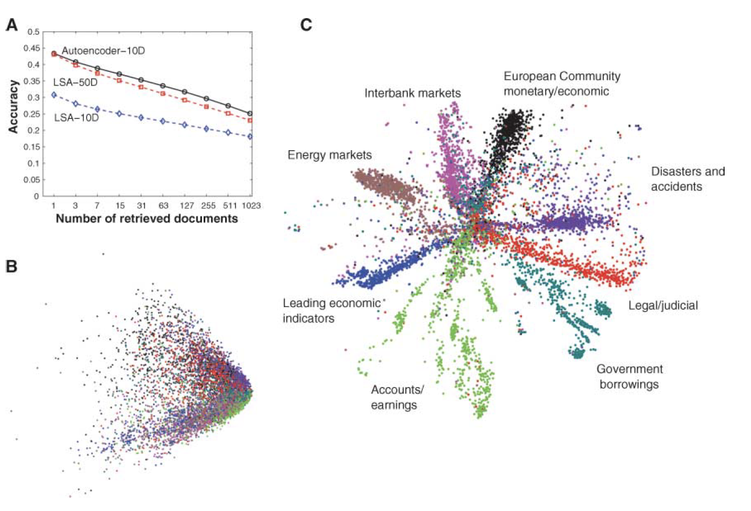
Document Embedding
can see clear separation of classes
Autoencoder
PCA

Slide 9
Regularized Autoencoders
Undercomplete AEs can fail to learn anything useful if the capacity is too large
Meaning, the complexity of mappings from layer to layer is too large
For linear case, they could learn to copy the input exactly
Regularized AEs modify the loss function to encourage desirable properties
Regularization plays against the reconstruction to learn meaningful embeddings
Regularizations express inductive bias in the solution
For example, sparse solutions, smooth ones etc
Notes:
Meaning, the complexity of mappings from layer to layer is too large
For linear case, they could learn to copy the input exactly

Slide 10
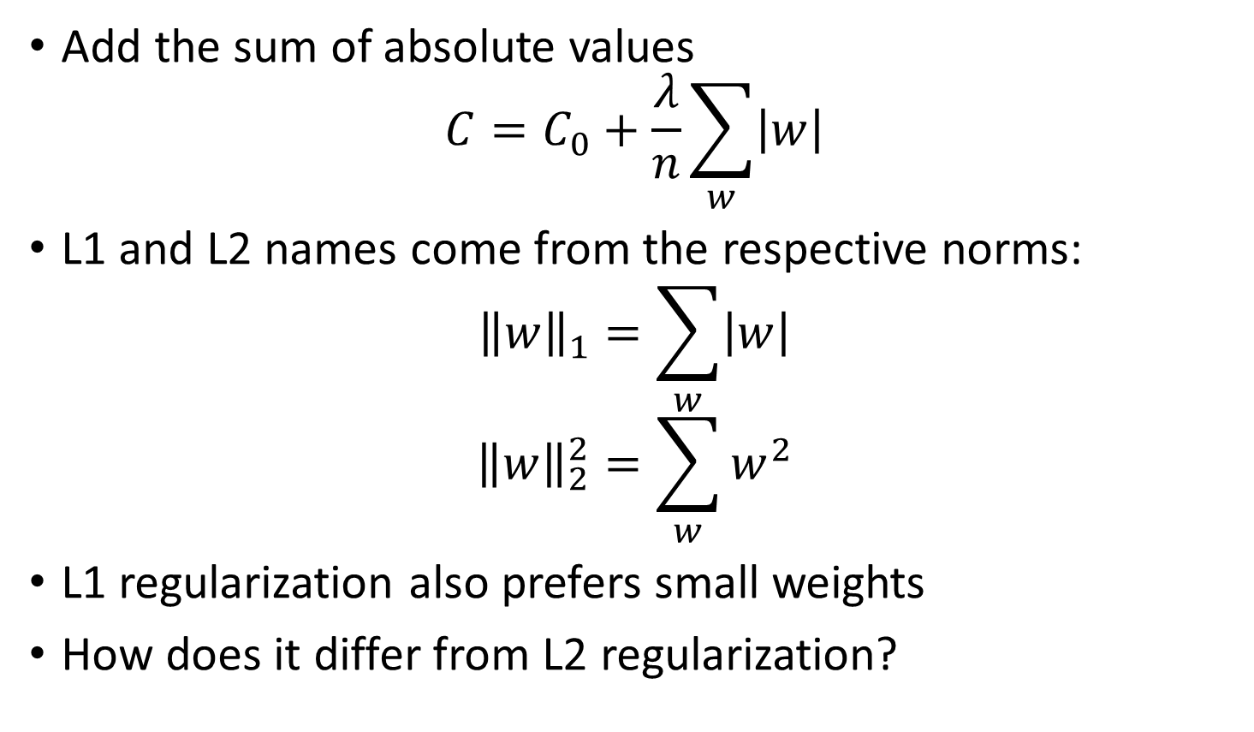
L1, L2 regularization
Add the sum of absolute values
$$C=C_{0}+\frac{λ}{n}\sum_{w}{\left|w\right|}$$
L1 and L2 names come from the respective norms:
$${\left\|w\right\|}_{1}=\sum_{w}{\left|w\right|}$$
$${\left\|w\right\|}_{2}^{2}=\sum_{w}{w^{2}}$$
L1 regularization also prefers small weights
How does it differ from L2 regularization?
for regularization, can have n of L_n to be any number
n = 10, shrink weight
n = fractional, emphasize sparsity

Slide 11
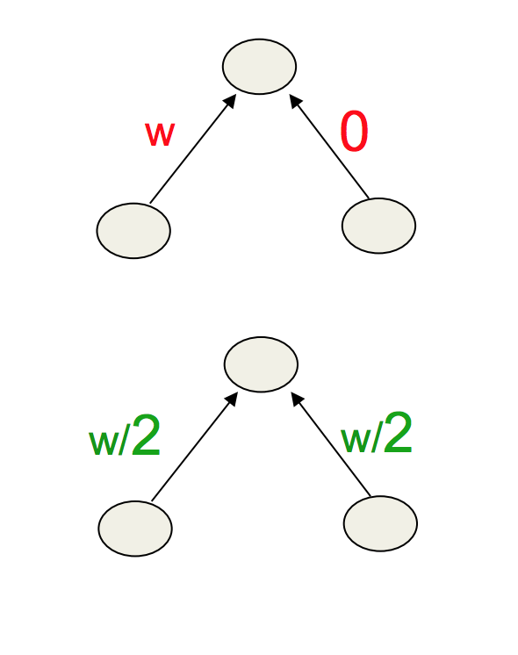
L1 vs L2
L1 prefers sparse solutions, turn off some activations
L2 prefers to share smaller weights, to make propagation noiseless
L2 is More Convex

Slide 12
L1 vs L2
 | L1 | L2
Computation efficiency | Efficient Reason: analytical solution | inefficient
output | Non-sparse | sparse
Feature selection | No But small weights are resilient to noise | Built-in

Slide 13
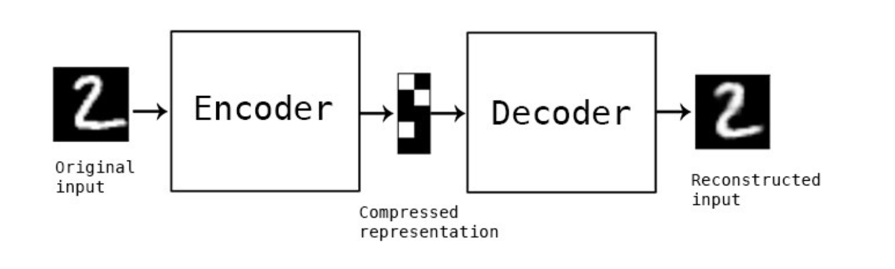
Autoencoding MNIST

Slide 14
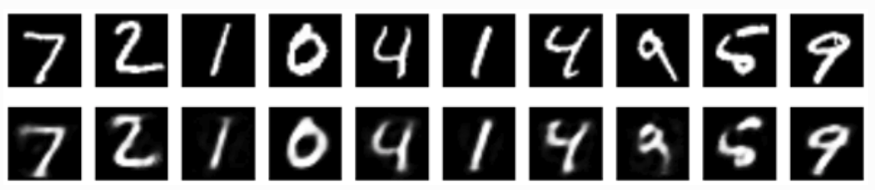

Autoencoding MNIST
Single hidden layer with 32 nodes, fully connected layers
Cross-entropy loss per pixel, ReLU activations
Train for 50 epochs
Reaches a stable train/test loss of 0.11
Top $=$ original, bottom $=$ reconstructed digits

Slide 15
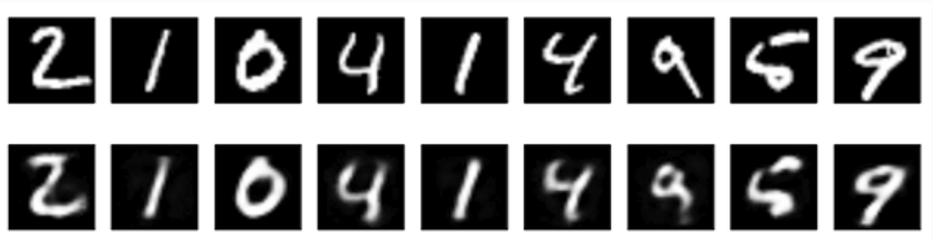

Autoencoding MNIST
Single hidden layer with 32 nodes, fully connected layers
Cross-entropy loss per pixel, ReLU activations
Add L1 sparsity penalty to hidden layer
Train for 100 epochs
Train loss 0.11, test loss 0.10
Top $=$ original, bottom $=$ reconstructed digits
Look the same, but sparser code

Slide 16
Exercise
1. Design an autoencoder that separates clusters widely
What kind of regularizations would do this?
keep dim of code z layer sparse
L-fractional regularization
penalize entropy of activation

Slide 17
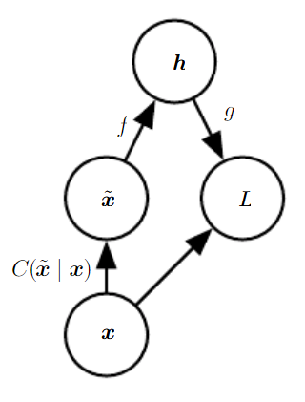
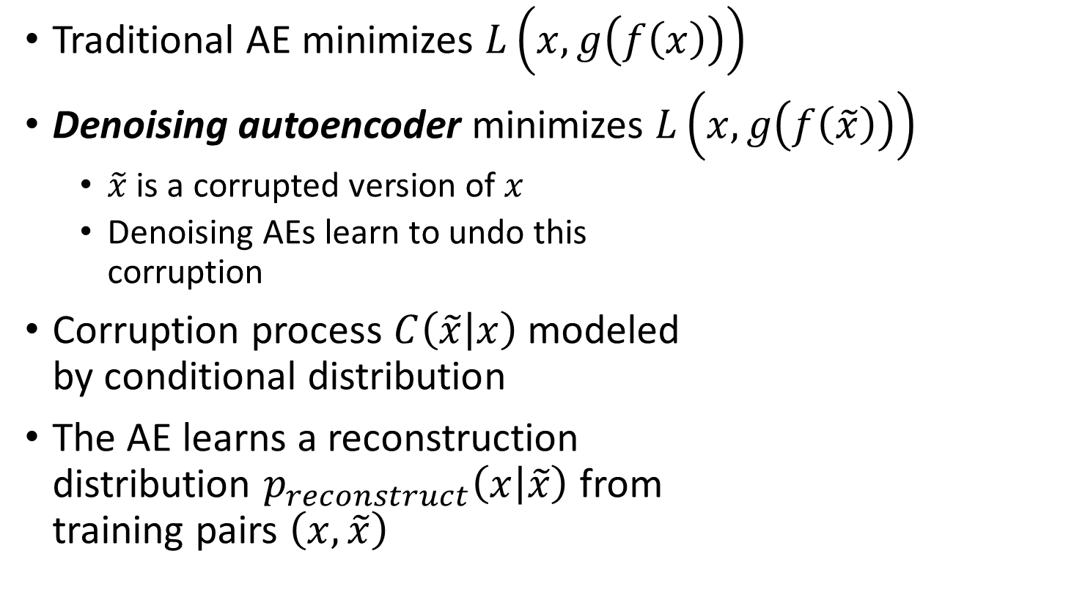

Denoising Autoencoders
if an algo can do dim reduction, often it can denoise as well
Traditional AE minimizes $L\left(x,g\left(f\left(x\right)\right)\right)$
Denoising autoencoder minimizes $L\left(x,g\left(f\left(\tilde{x}\right)\right)\right)$
$\tilde{x}$ is a corrupted version of $x$
Denoising AEs learn to undo this corruption
Corruption process $C\left(\tilde{x} | x\right)$ modeled by conditional distribution
The AE learns a reconstruction distribution $p_{reconstruct}\left(x | \tilde{x}\right)$ from training pairs $\left(x,\tilde{x}\right)$
$$z$$

Slide 18
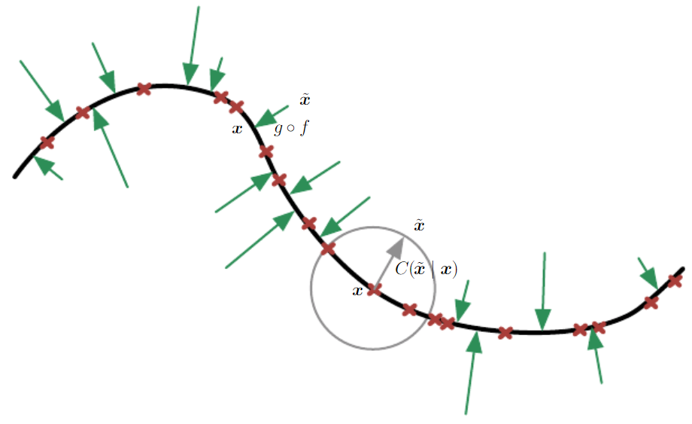
Denoising and Manifold Learning
Red points are the training data,
green arrows indicate the correction back.
Notes:
Red points are the training data, green arrows indicate the correction back.

Slide 19
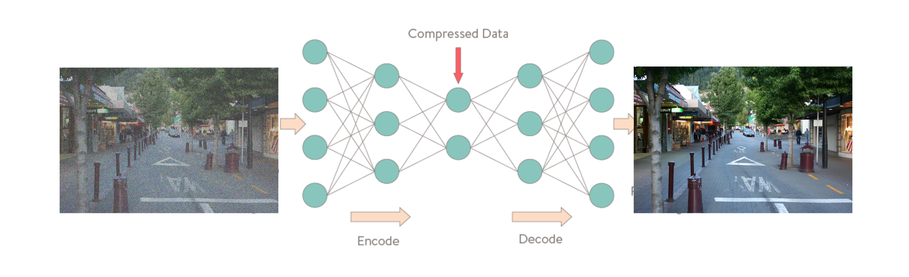
Application to Image Denoising
noisy image
noiseless image

Slide 20
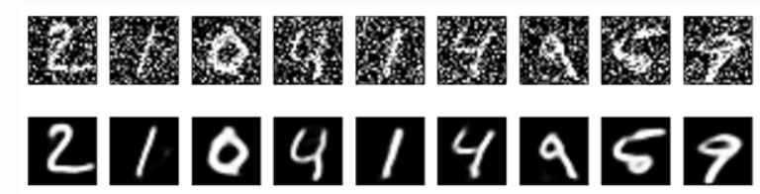

Denoising MNIST
Denoising autoencoder
Add Gaussian noise
Top $=$ noisy original, bottom $=$ reconstructed digits
MNIST with salt-pepper noise
reconstructed digits

Slide 21
Exercise
We have seen autoencoders used for embedding and denoising.
What other uses can autoencoders have?
Dimensionality reduction
Information retrieval
Anomaly detection: By learning to replicate the most salient features in the training data under some of the constraints described previously, the model is encouraged to learn to precisely reproduce the most frequently observed characteristics. When facing anomalies, the model should worsen its reconstruction performance. In most cases, only data with normal instances are used to train the autoencoder; in others, the frequency of anomalies is small compared to the observation set so that its contribution to the learned representation could be ignored. After training, the autoencoder will accurately reconstruct "normal" data, while failing to do so with unfamiliar anomalous data.[32] Reconstruction error (the error between the original data and its low dimensional reconstruction) is used as an anomaly score to detect anomalies.[32]
Recent literature has however shown that certain autoencoding models can, counterintuitively, be very good at reconstructing anomalous examples and consequently not able to reliably perform anomaly detection
Image processing
Drug discovery
Popularity prediction

Slide 22
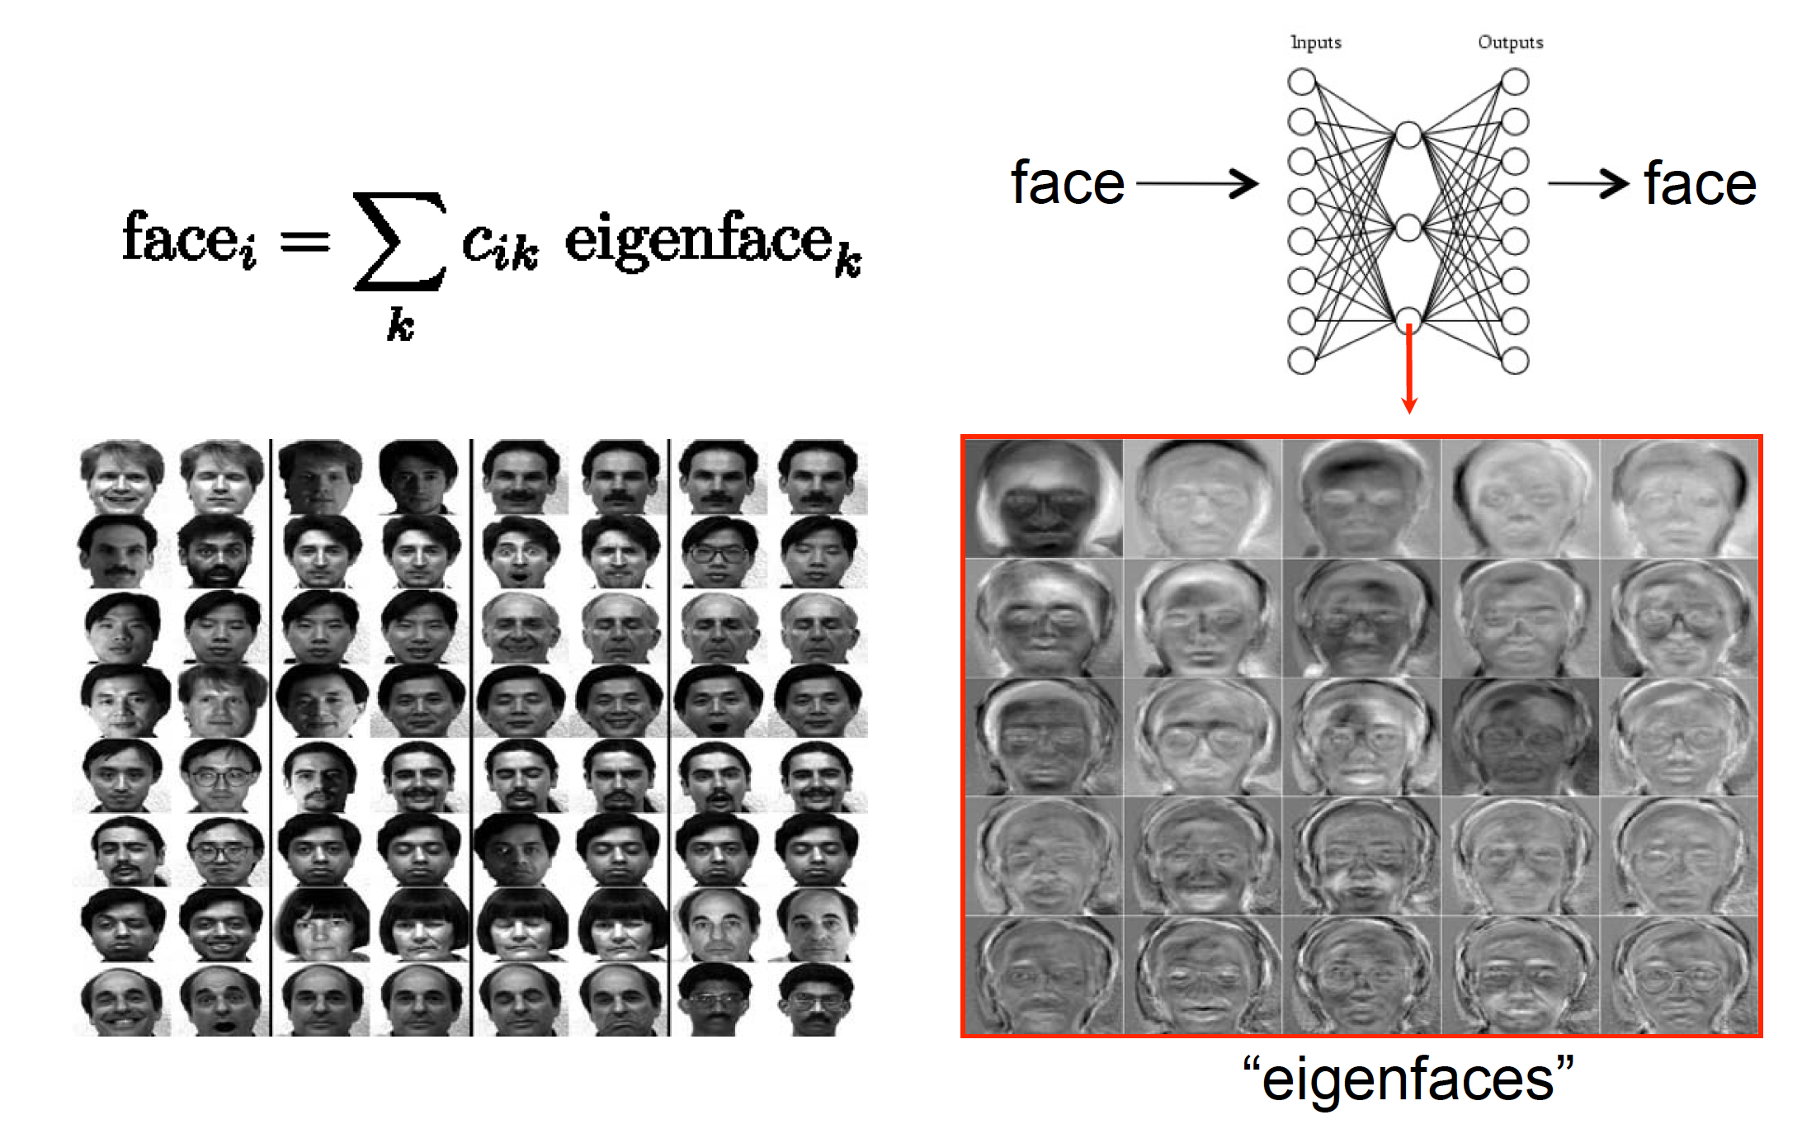
PCA as Minimizing Reconstruction Error

Slide 23
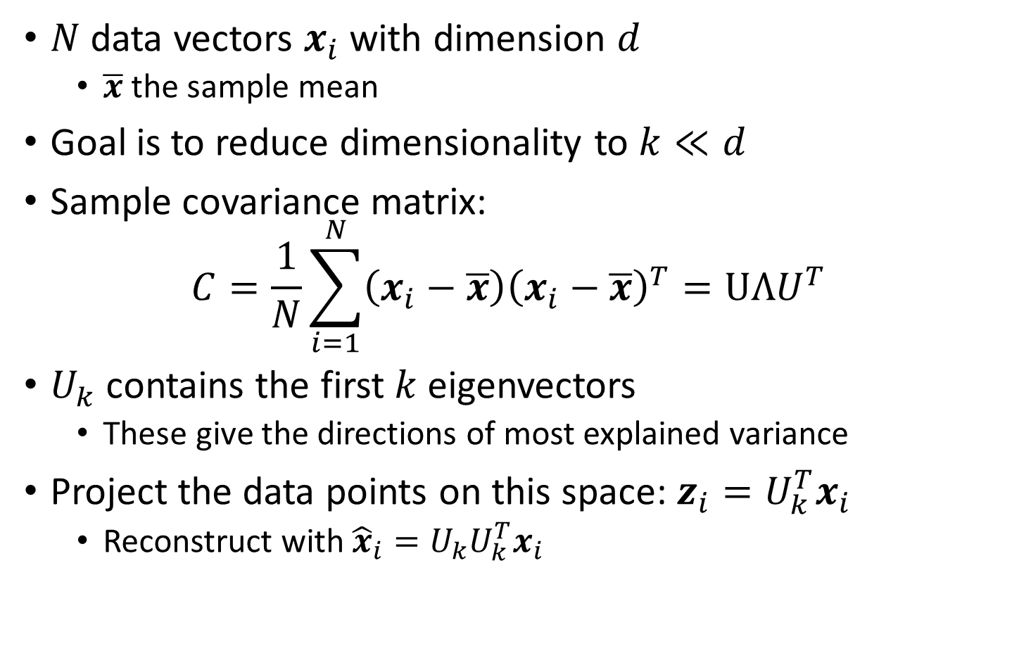
PCA: Maximize Variance
$N$ data vectors $x_{i}$ with dimension $d$
$\overline{x}$ the sample mean
Goal is to reduce dimensionality to $k≪d$
Sample covariance matrix: $C=\frac{1}{N}\sum_{i=1}^{N}{\left(x_{i}−\overline{x}\right){\left(x_{i}−\overline{x}\right)}^{T}}=UΛU^{T}$
$U_{k}$ contains the first $k$ eigenvectors
These give the directions of most explained variance
Project the data points on this space: $z_{i}=U_{k}^{T}x_{i}$
Reconstruct with ${\hat{x}}_{i}=U_{k}U_{k}^{T}x_{i}$
Notes:
This gives the lower dimensional representation

Slide 24
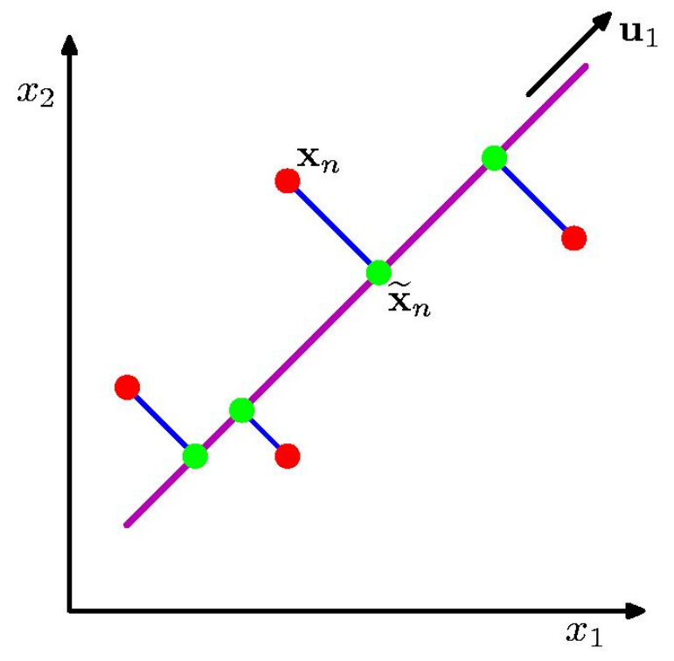
PCA: Two Views
Maximize variance (scatter of green points)
Minimize error (red-green distance per data point)

Slide 25
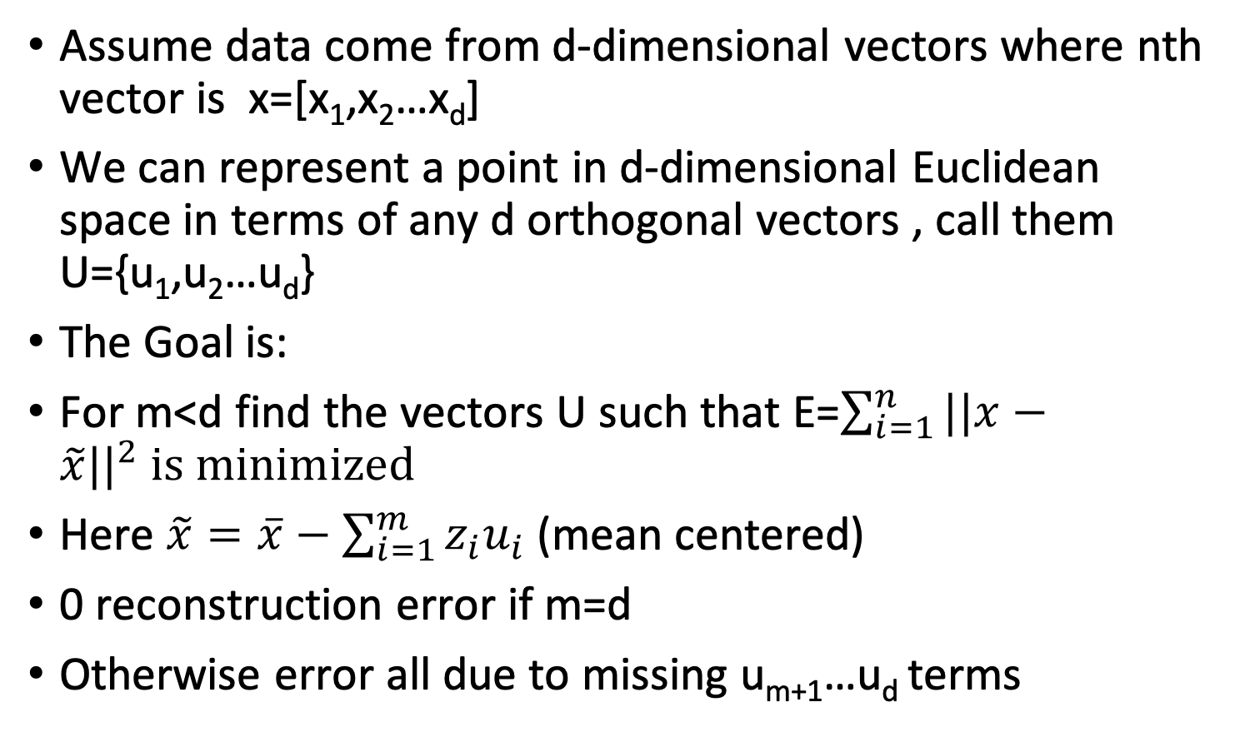
Reconstruction
Assume data come from d-dimensional vectors where nth vector is x=[x₁,x₂…x_{d}]
We can represent a point in d-dimensional Euclidean space in terms of any d orthogonal vectors , call them U={u₁,u₂…u_{d}}
The Goal is:
For m<d find the vectors U such that E=$\sum_{i=1}^{n}{||x−}$ $\tilde{x}{||}^{2} is minimized$
Here $\tilde{x}=\overline{x}−\sum_{i=1}^{m}{z_{i}u_{i}}$ (mean centered)
0 reconstruction error if m=d
Otherwise error all due to missing u_{m+1}…u_{d} terms

Slide 26
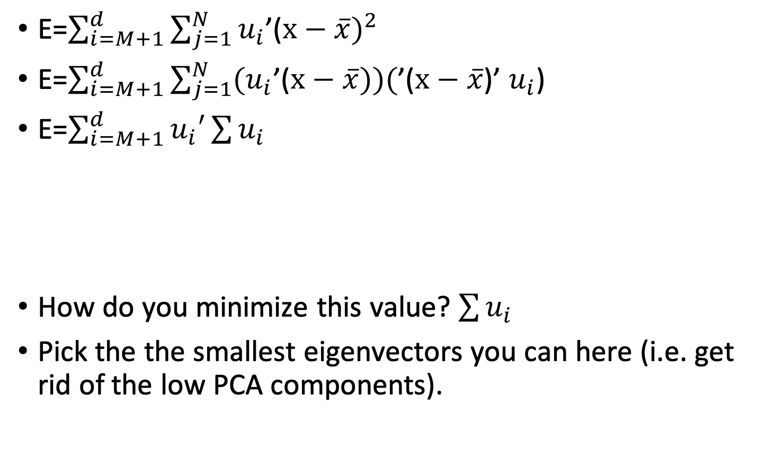
Reconstruction
E=$\sum_{i=M+1}^{d}{\sum_{j=1}^{N}{u_{i}}}$’($x−\overline{x})^{2}$
E=$\sum_{i=M+1}^{d}{\sum_{j=1}^{N}{{(u}_{i}}}$’($x−\overline{x}))($’($x−\overline{x}$)’ $u_{i}$)
E=$\sum_{i=M+1}^{d}{u_{i}′}\sum{u_{i}}$
How do you minimize this value? $\sum{u_{i}}$
Pick the the smallest eigenvectors you can here (i.e. get rid of the low PCA components).
Covariance matrix

Slide 27
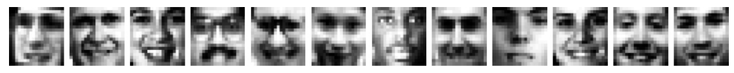
PCA on facial images
PCA applied to 2429 $19×19$ images from CBCL dataset
Reconstruction with only 3 components:

Slide 28
Exercise
How can autoencoders be used for data generation?
What are some issues with this?

